Slide 1
Columbus North High School Band Fundraisers

Slide 2
Year Round Opportunities:
Scrip | Kroger | Amazon Smile

Slide 3
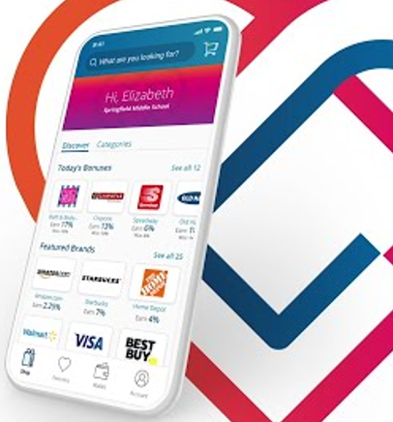
Scrip
Don’t change how you shop.
Change how you pay!

Slide 4
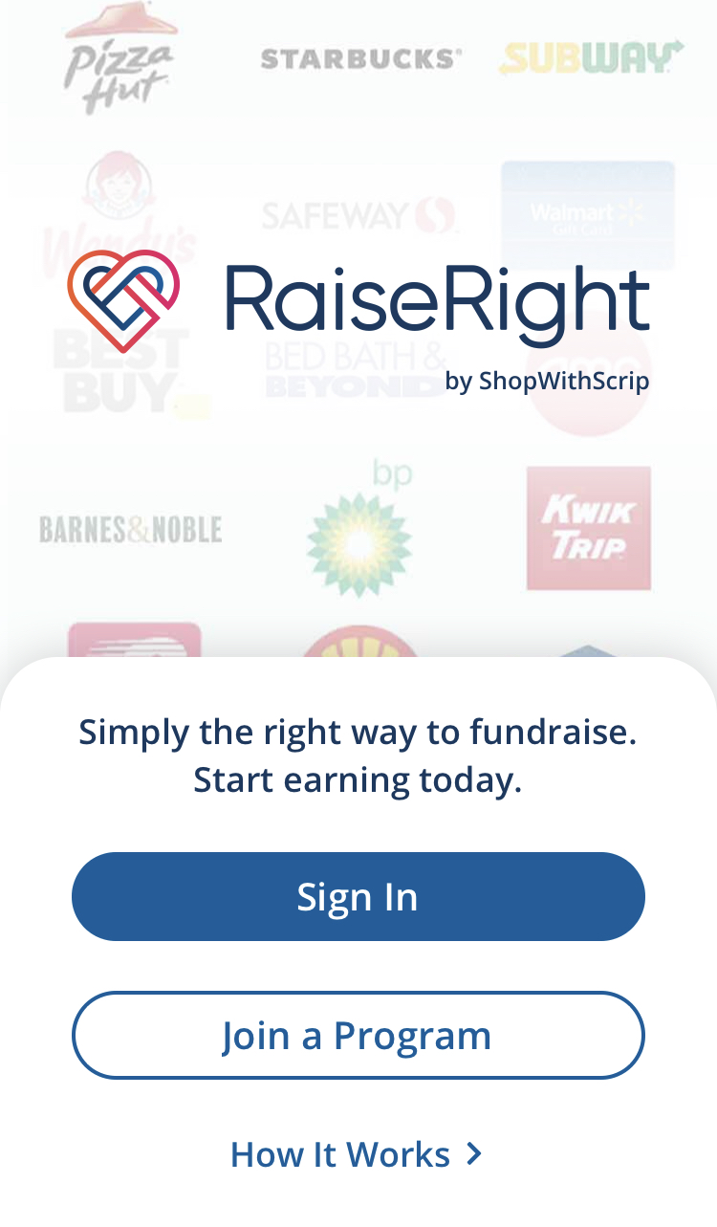
How to get started with Scrip
Step 1
Create an account at www.shopwithscrip.com (Enrollment Code 97793EDF1676L)
Step 2
Add your bank account or credit card
Step 3
Download the RaiseRight App
Step 4
Shop over 700 stores and restaurants
Step 5
100% of monthly rebates paid to your student account

Slide 5
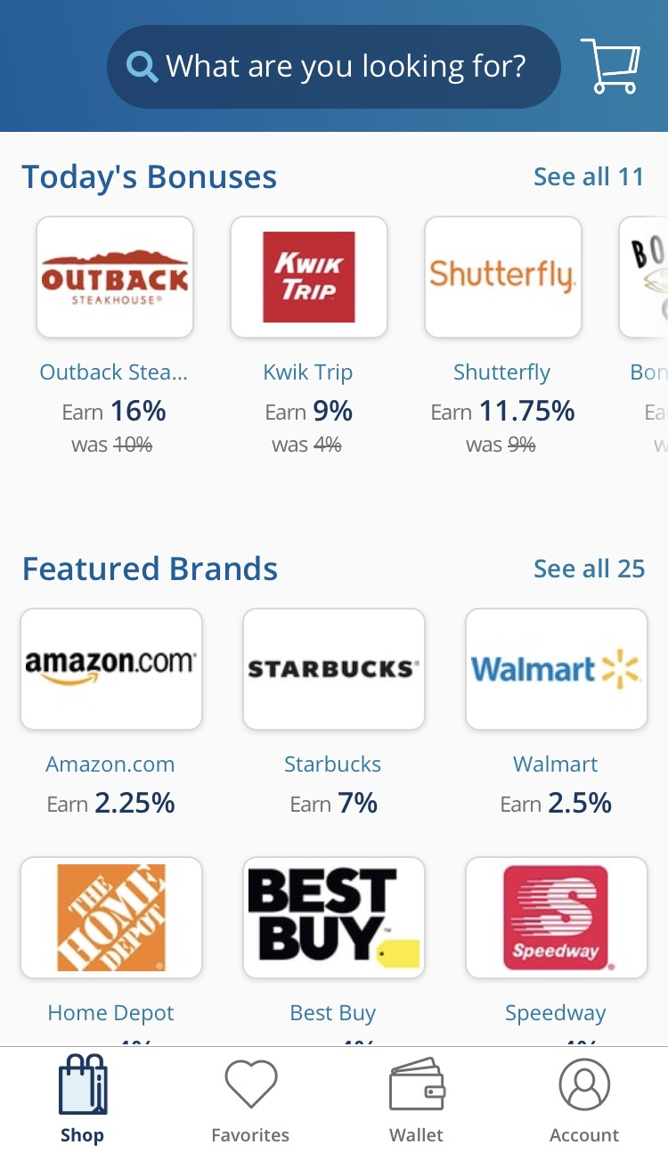
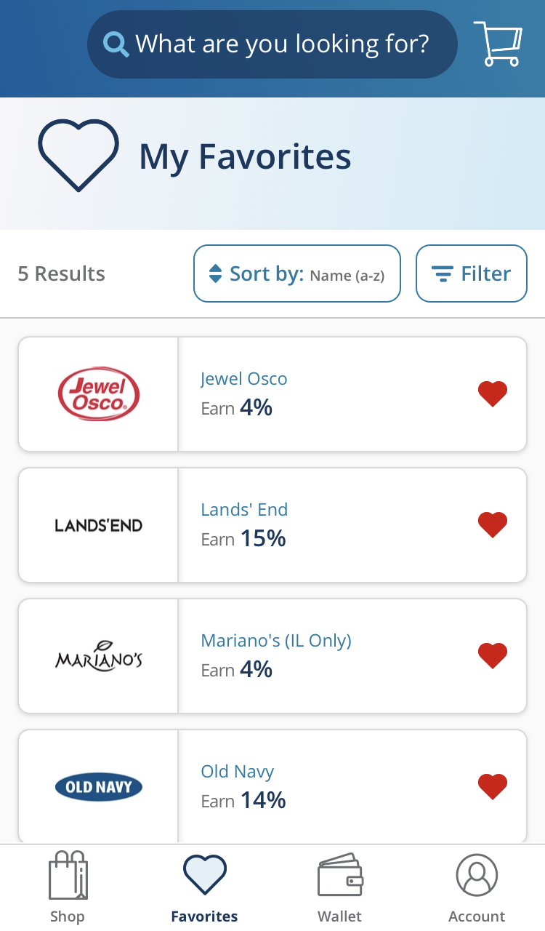
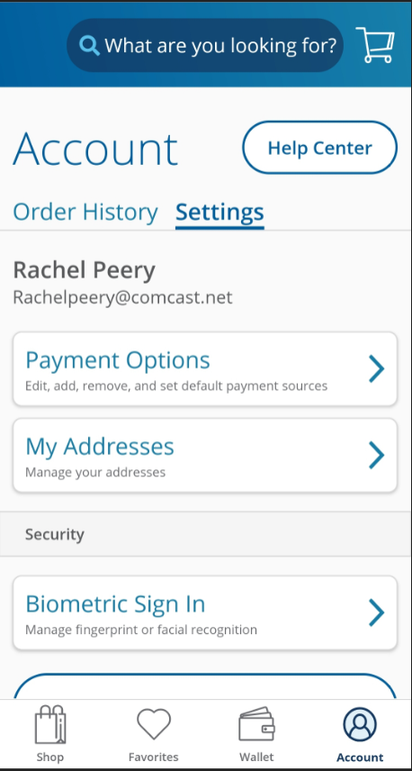
Using the APP
Shop
Favorites
Wallet
Account

Slide 6
Why use Scrip?
100% of rebate goes into your band students account and you only pay a small fee per transaction.
Fees:
Bank Account ($0.15 fee)
Credit Card (2.6% fee)
This Photo by Unknown Author is licensed under CC BY-SA

Slide 7
Card Types
Non-reloadable Cards
You Order
Delivered monthly by Scrip Coordinator
Reloadable Cards
You Order
Delivered monthly by Scrip Coordinator
You reload. (Most reloads are immediate and some are overnight)
E-Cards Instant
Purchase on-the-go and use within minutes
Buy while standing in line at check-out

Slide 8
Kroger Community Rewards
Kroger Loyalty Card:
Gives you discounts on groceries
Earns money quarterly for your student account
This Photo by Unknown Author is licensed under CC BY

Slide 9
How to get started with Kroger Rewards
Sign up
Sign up for a Kroger Loyalty Card
Log In
Log into My Account (Select Community Rewards)
Select
Select your Organization as Columbus North High School Band Boosters (Org ID MS458)
Take a picture quarterly and email it to your Scrip Coordinator (Rachelpeery@comcast.net)
Email
Receive
100% of your contributions to Columbus North High School Band Boosters are applied to your student account

Slide 10
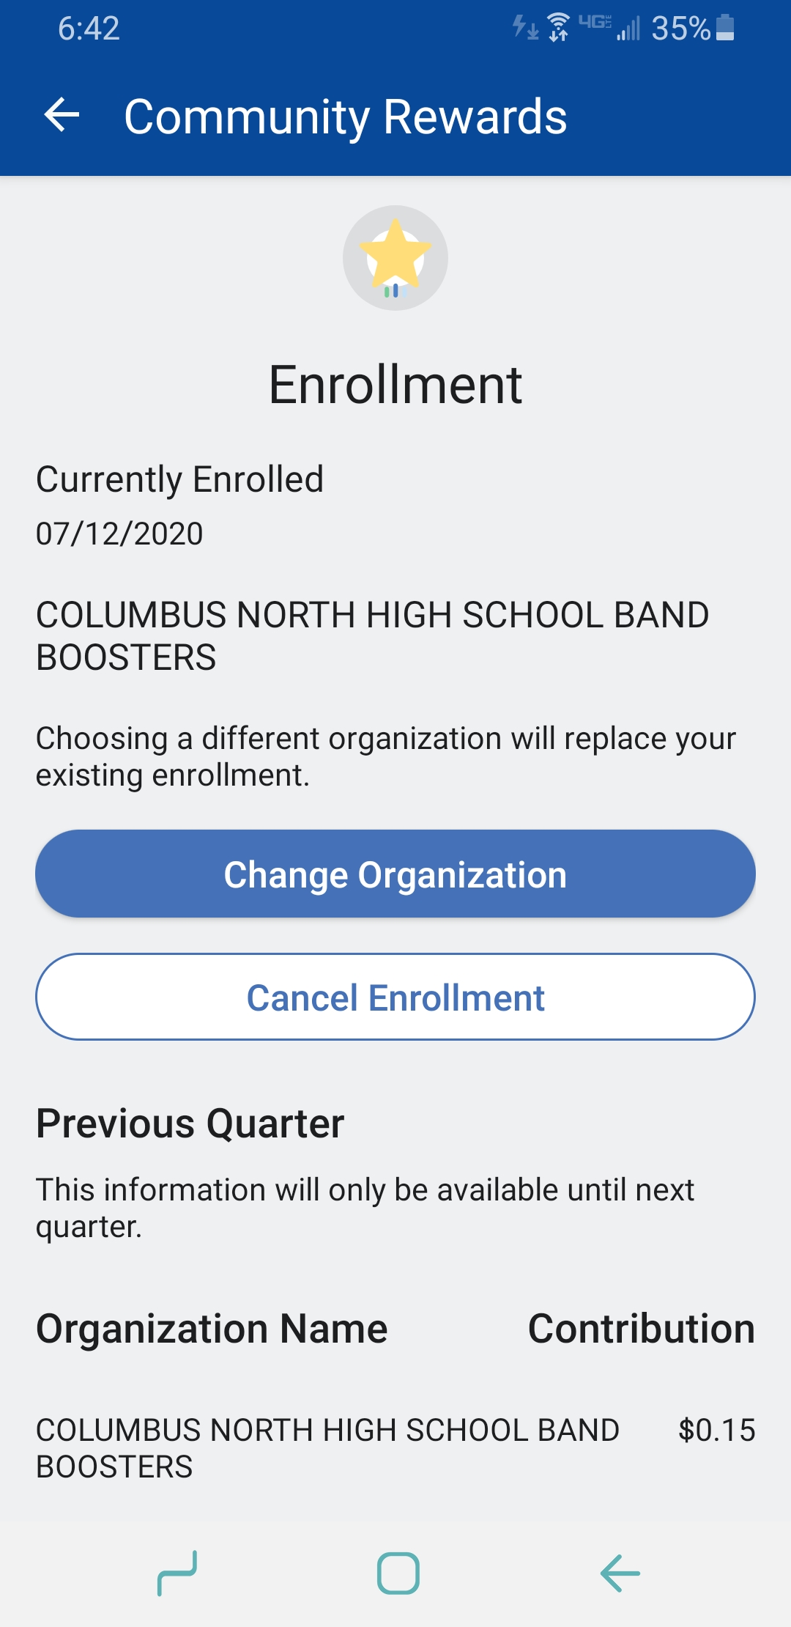
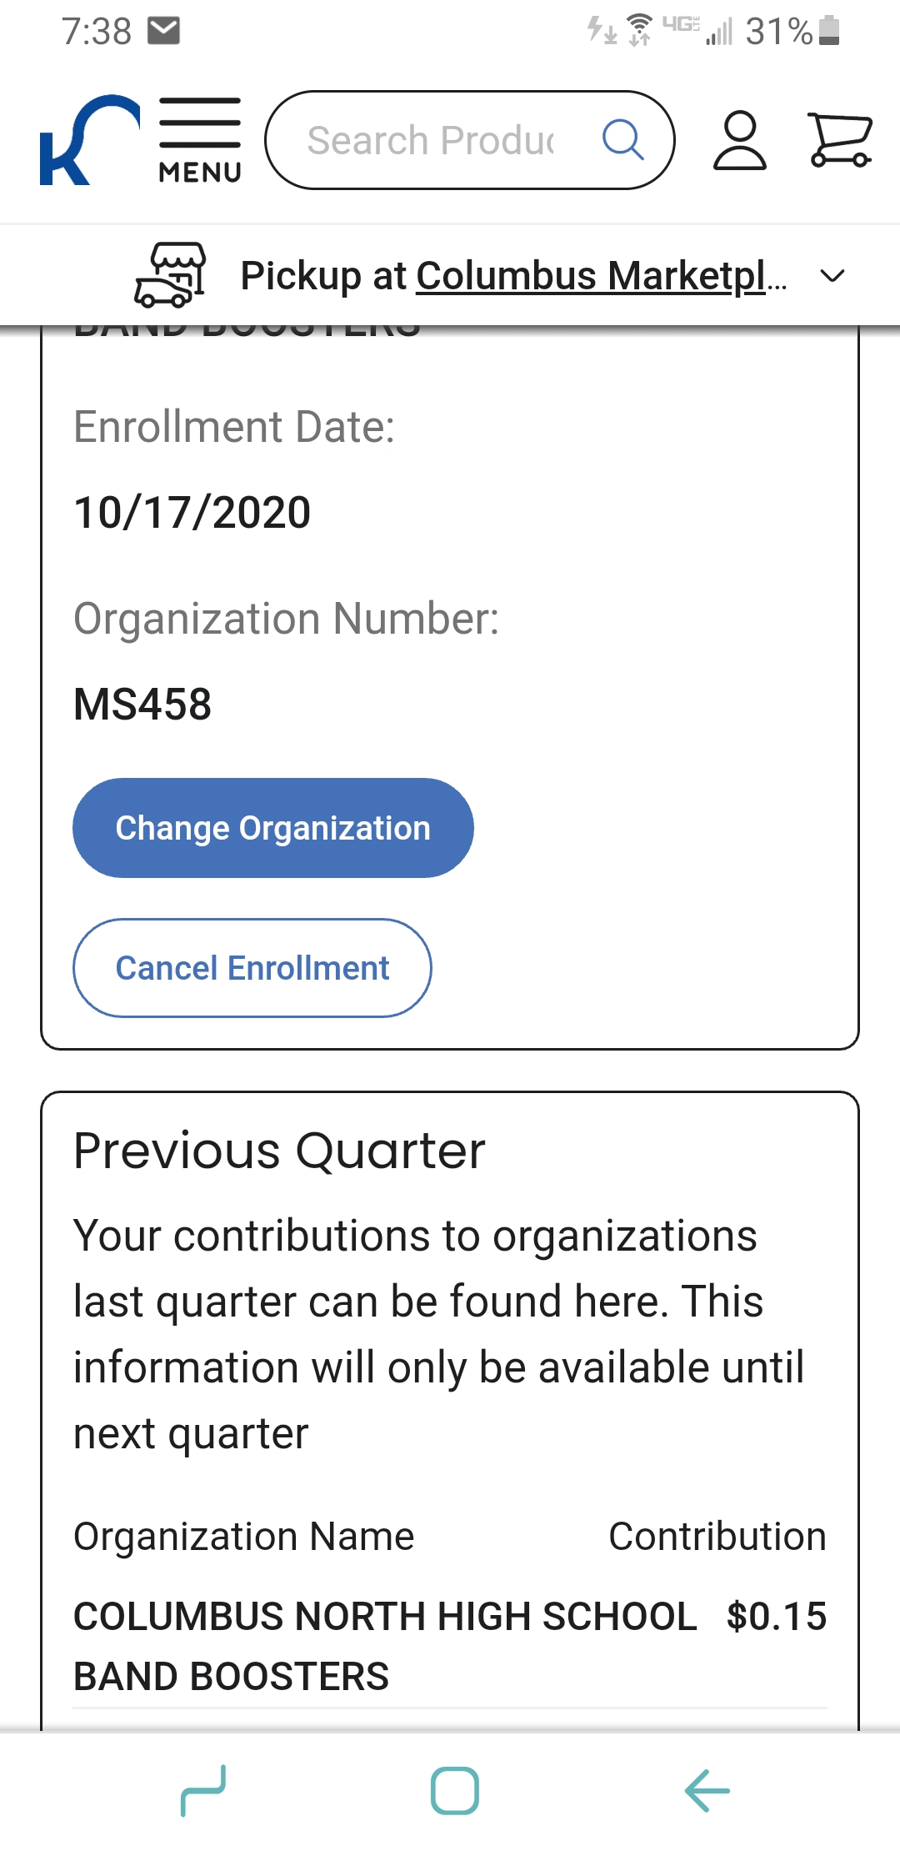
Kroger Community Rewards
Mobile Screen
APP Screen

Slide 11
Amazon Smile
Go to smile.amazon.com
Select Columbus North High School Band Boosters Association as your preferred charity
The band will receive .5% of eligible purchases
This helps keep your band fees low

